Slide 1

Final Project: Optimal Capital Structure
Yicheng Wang (yw1273)
Dongfang Wang (dw2424)

Slide 2

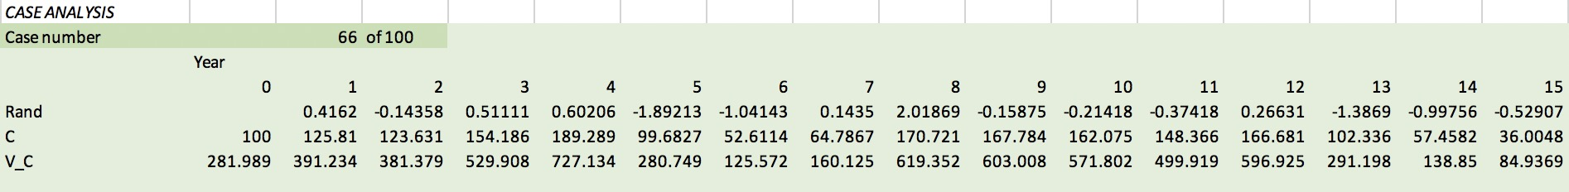
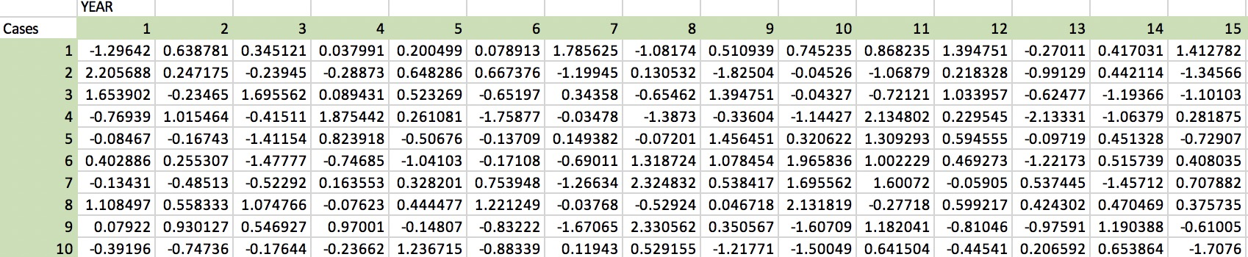
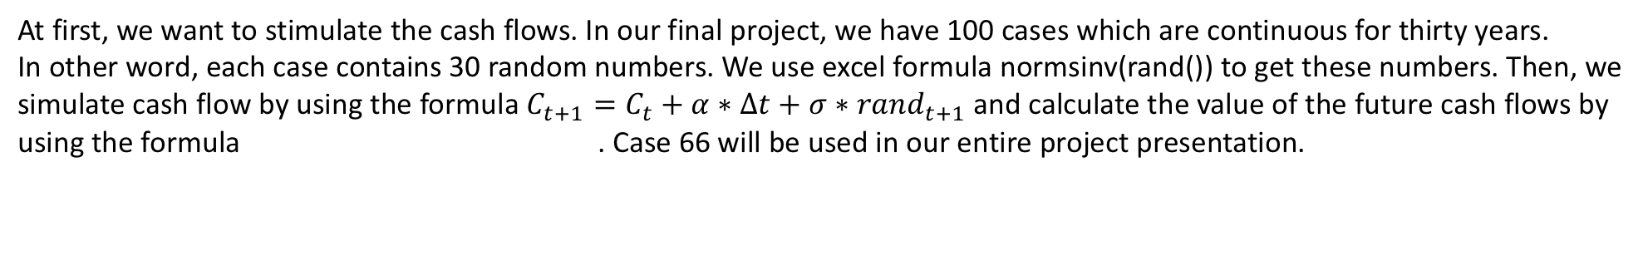
At first, we want to stimulate the cash flows. In our final project, we have 100 cases which are continuous for thirty years.
In other word, each case contains 30 random numbers. We use excel formula normsinv(rand()) to get these numbers. Then, we simulate cash flow by using the formula $C_{t+1}=C_{t}+α∗∆t+σ∗{rand}_{t+1}$ and calculate the value of the future cash flows by using the formula . Case 66 will be used in our entire project presentation.
This is random number table in the excel file.

Slide 3
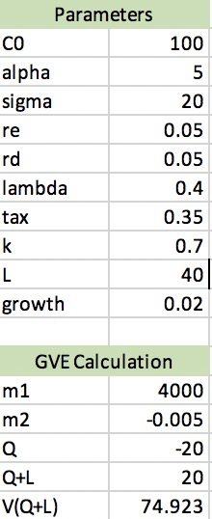
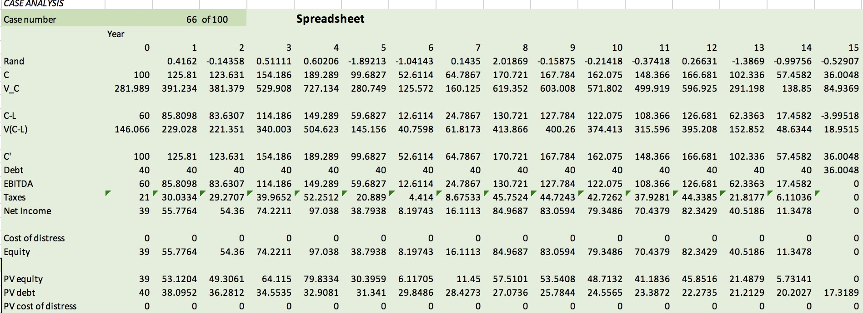
Build the Spreadsheet
C’ is the cash flow when the company with limit liability option
EBITDA is the cash flow before the tax
Cost of distress = Iambda * V(Q+L)
We use formula Equity/(1+risk-free rate)^year to calculate the PV of equity
We use formula Debt/(1+risk-free rate)^year to calculate the PV of Debt

Slide 4
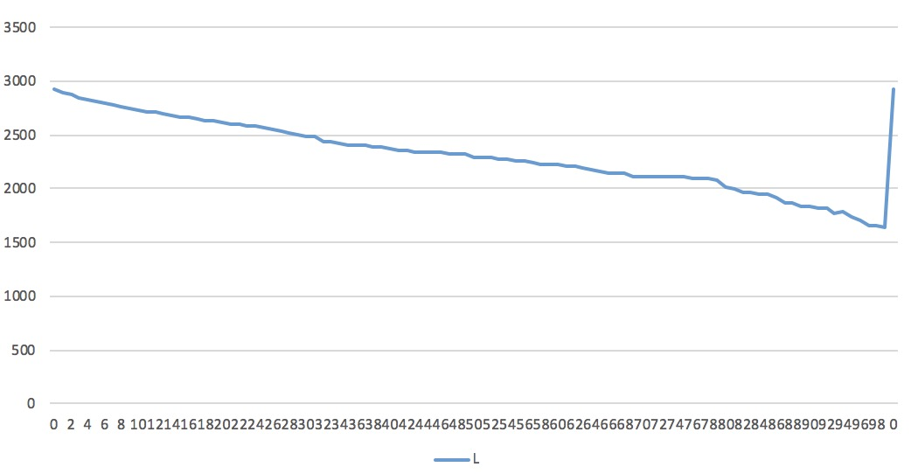
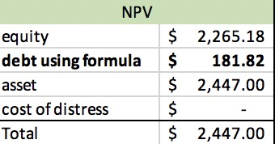

Find the Optimal Level of L
There are two methods to find the optimal level of L by using Excel. We decide to use data-table tool but not Solver to find the optimal level of L that maximize the present value of Equity + Debt. At first, we use the formula D=L/r*(1-p^m2^L)+V*(Q+C)*(1-ג)*e^m2^L and find that the optimal level of L is 0 , so we try the present value of D and find the optimal level of L is 78.
By using formula of Debt

Slide 5
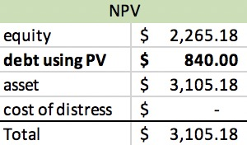
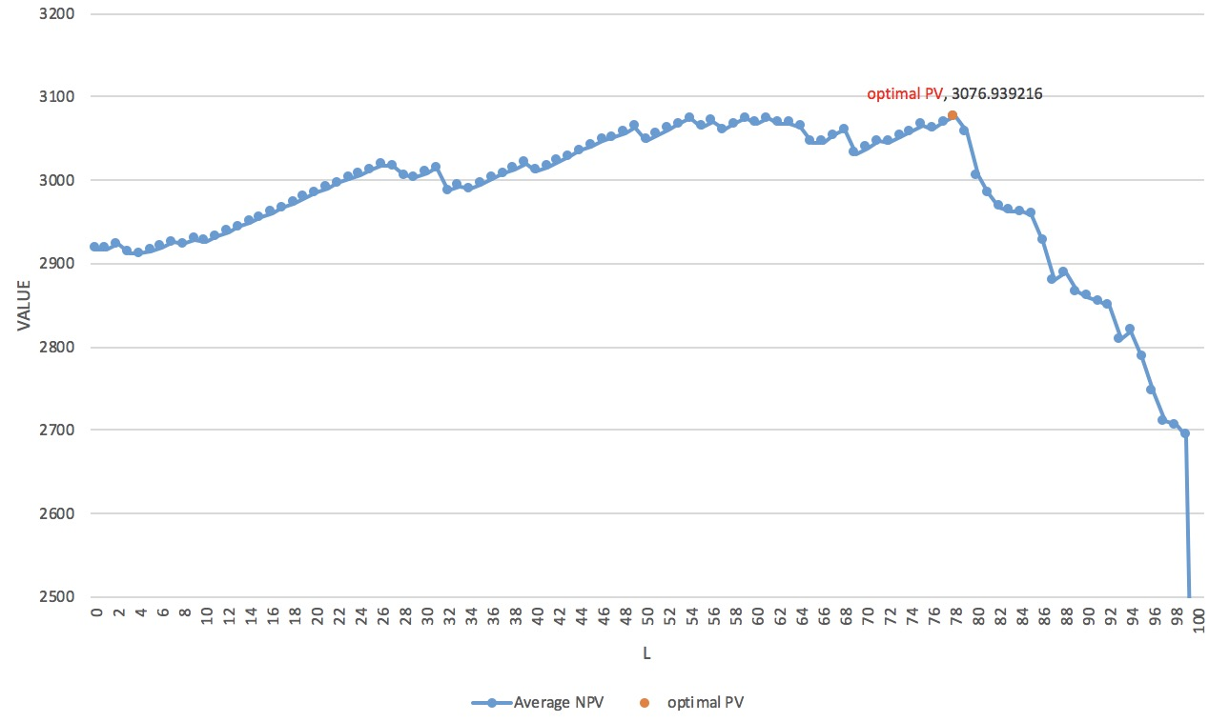

By Using Present Value of Debt

Slide 6
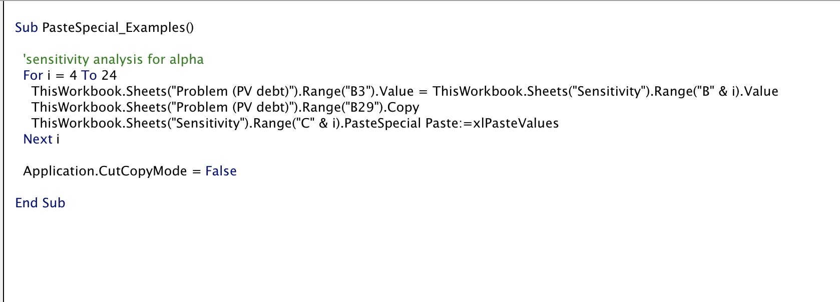
Sensitivity Analysis
We use VBA to find the optimal level of L under different parameters. VBA code that keep other parameters fixed should look like this.

Slide 7
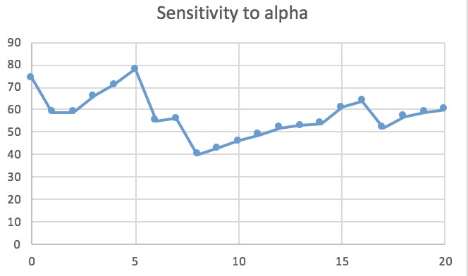
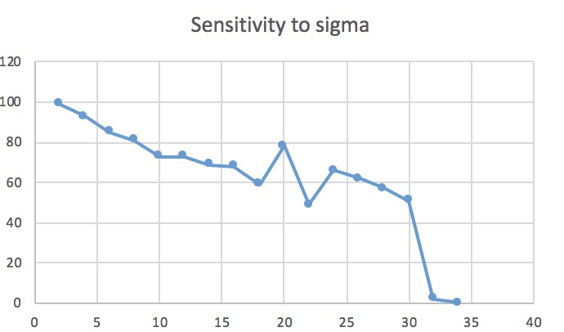
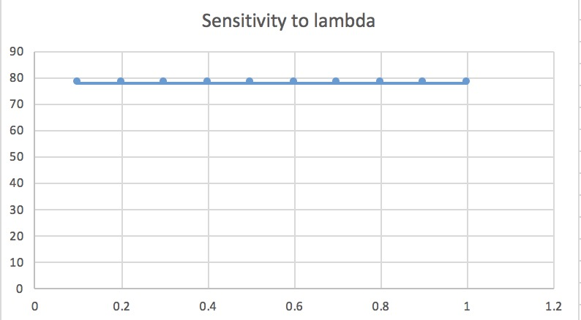
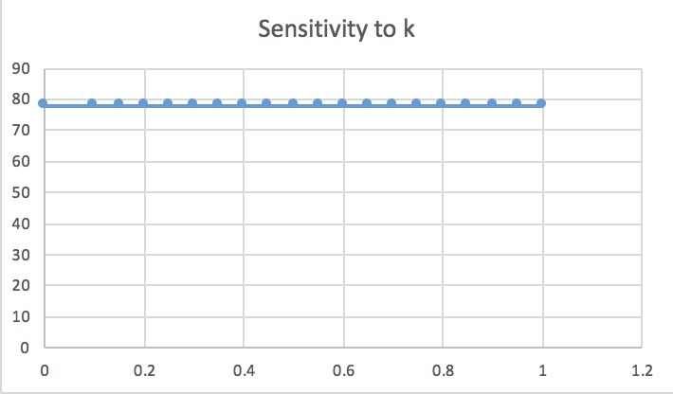
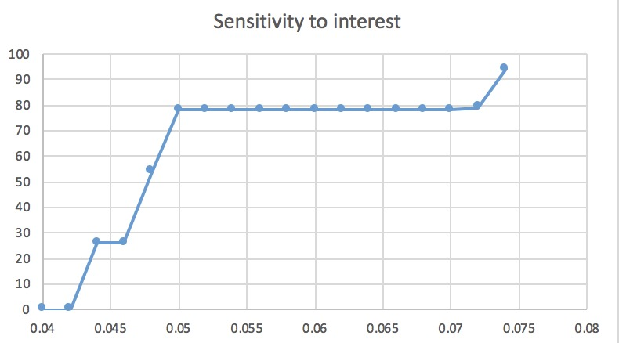
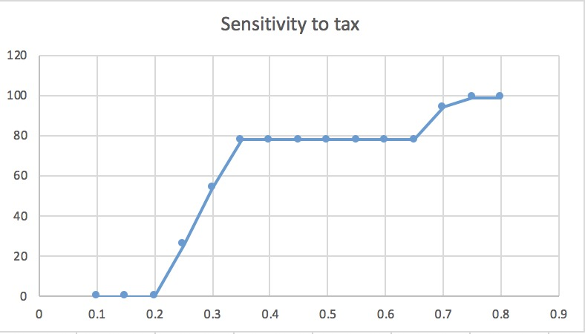
Sensitivity graphs and conclusion
We find that optimal level of L has positive correlations with interest and tax. However, optimal level of L has negative correlations with alpha and sigma. In addition to these, Iambda and k seem not important when determining the optimal level of L. From the graphs, we can see that the optimal level of L is quite sensitive to alpha and sigma, but less sensitive to interest and tax.

Slide 8
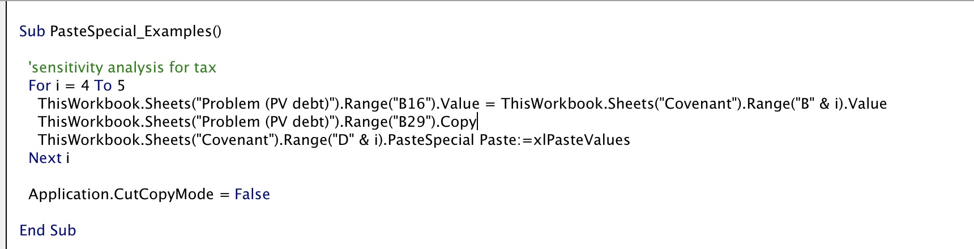

Find the Optimal Level of L with Covenant
We use the VBA to calculate the optimal level of L with covenant. The VBA code should look like this.
We find the optimal level of L decline from 78 to 54 with the covenant.

Slide 9
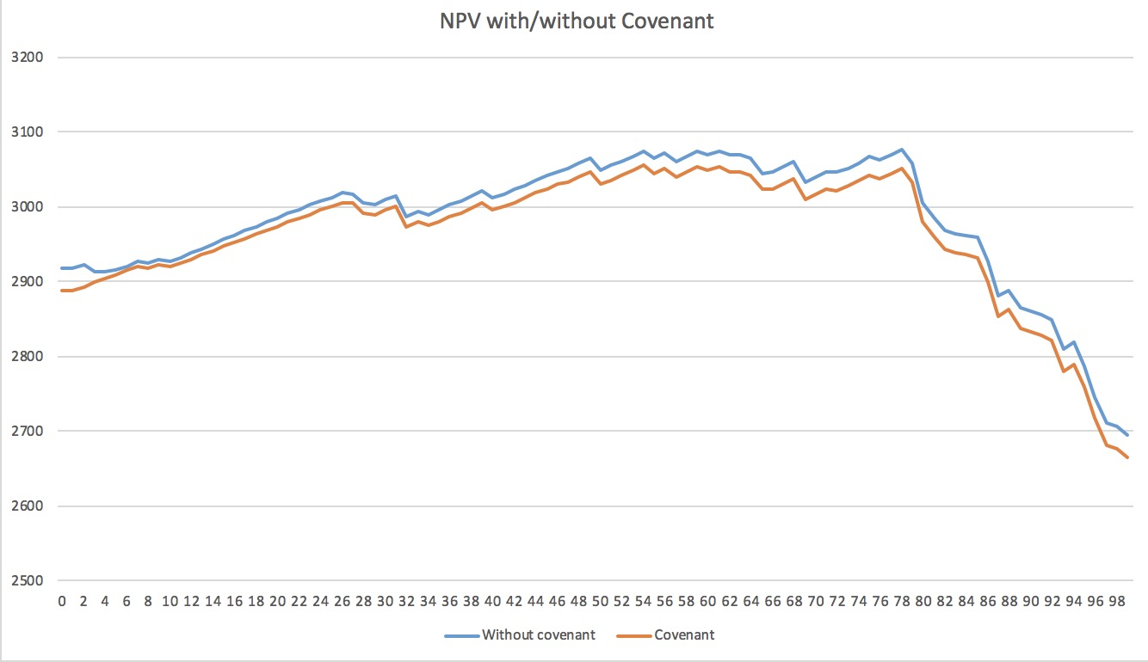
Graph of Optimal Level of L with Covenant/without Covenant
We think the covenant does not make a difference since NPV with covenant only decreases a little compared with that without covenant.

